Slide 1
Cindy Sherman
Untitled Film Stills
http://www.temple.edu/photo/photographers/cindy/film/sherman.htm
http://www.cindysherman.com/art.shtml
Project reference for ‘character identity’. > PHOTO 2

Slide 2
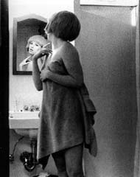
Cindy Sherman
Untitled Film Still #2

Slide 3
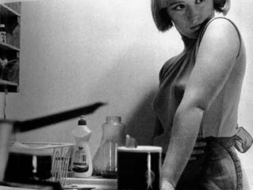
Cindy Sherman
Untitled Film Still #3

Slide 4
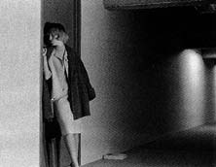
Cindy Sherman
Untitled Film Still #4

Slide 5
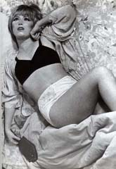
Cindy Sherman
Untitled Film Still #6

Slide 6
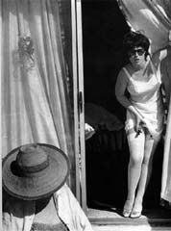
Cindy Sherman
Untitled Film Still #7

Slide 7
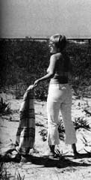
Cindy Sherman
Untitled Film Still #8
cropped

Slide 8
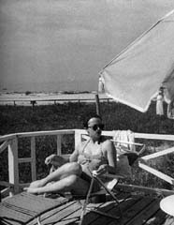
Cindy Sherman
Untitled Film Still #9
cropped

Slide 9
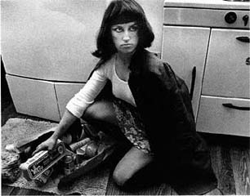
Cindy Sherman
Untitled Film Still #10

Slide 10
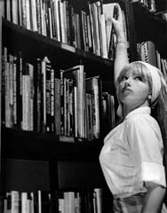
Cindy Sherman
Untitled Film Still #13

Slide 11
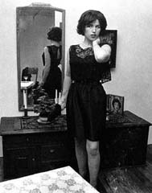
Cindy Sherman
Untitled Film Still #14

Slide 12
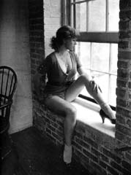
Cindy Sherman
Untitled Film Still #15

Slide 13
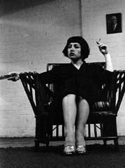
Cindy Sherman
Untitled Film Still #16

Slide 14
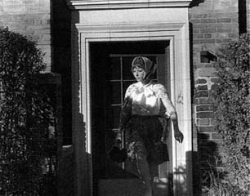
Cindy Sherman
Untitled Film Still #20

Slide 15
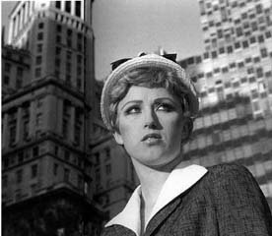
Cindy Sherman
Untitled Film Still #21

Slide 16
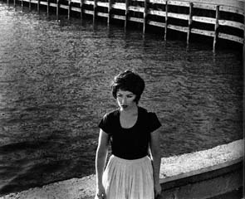
Cindy Sherman
Untitled Film Still #25

Slide 17
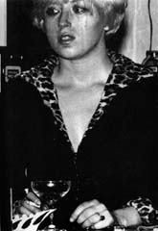
Cindy Sherman
Untitled Film Still #27

Slide 18
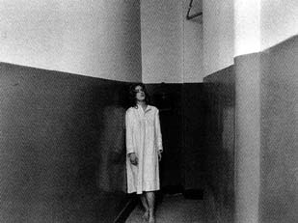
Cindy Sherman
Untitled Film Still #27b

Slide 19
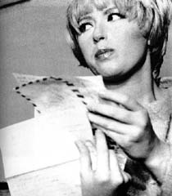
Cindy Sherman
Untitled Film Still #5
cropped

Slide 20
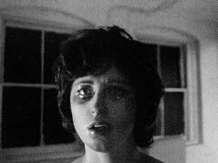
Cindy Sherman
Untitled Film Still #30

Slide 21
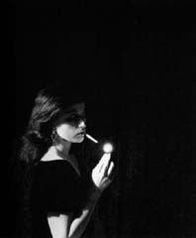
Cindy Sherman
Untitled Film Still #32 cropped

Slide 22
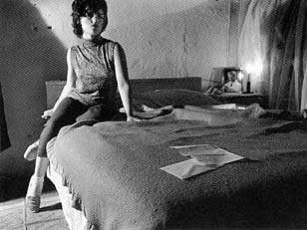
Cindy Sherman
Untitled Film Still #33

Slide 23
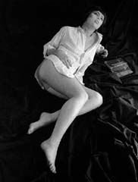
Cindy Sherman
Untitled Film Still #34

Slide 24
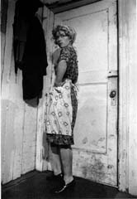
Cindy Sherman
Untitled Film Still #35

Slide 25
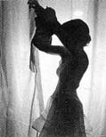
Cindy Sherman
Untitled Film Still #36

Slide 26
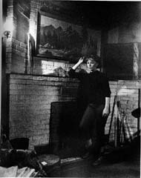
Cindy Sherman
Untitled Film Still #37

Slide 27
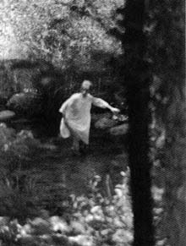
Cindy Sherman
Untitled Film Still #38

Slide 28
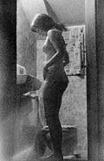
Cindy Sherman
Untitled Film Still #39

Slide 29
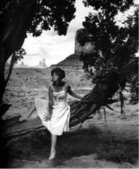
Cindy Sherman
Untitled Film Still #43 cropped

Slide 30
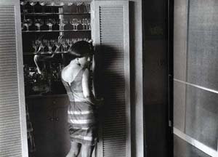
Cindy Sherman
Untitled Film Still #49

Slide 31
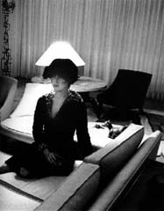
Cindy Sherman
Untitled Film Still #50

Slide 32
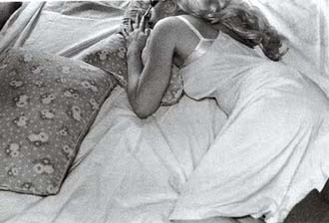
Cindy Sherman
Untitled Film Still #52

Slide 33
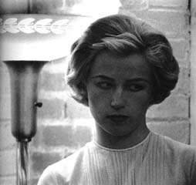
Cindy Sherman
Untitled Film Still #53 cropped

Slide 34
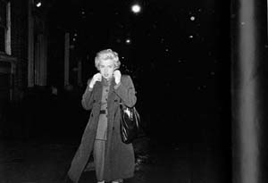
Cindy Sherman
Untitled Film Still #54

Slide 35
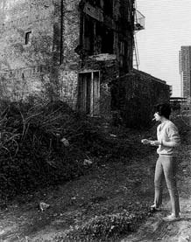
Cindy Sherman
Untitled Film Still #60

Slide 36
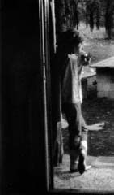
Cindy Sherman
Untitled Film Still #61

Slide 37
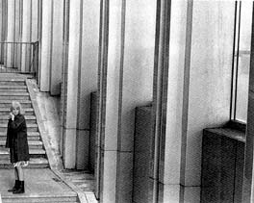
Cindy Sherman
Untitled Film Still #63

Slide 38
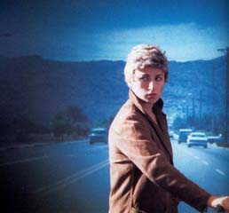
Cindy Sherman
Untitled Film Still #66

Slide 39
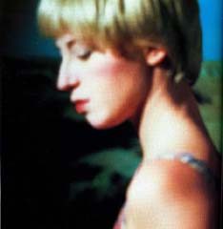
Cindy Sherman
Untitled Film Still #69

Slide 40
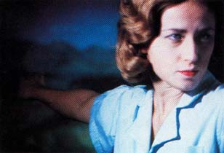
Cindy Sherman
Untitled Film Still #79

Slide 41
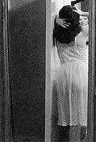
Cindy Sherman
Untitled Film Still #81

Slide 42
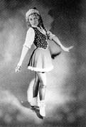
Cindy Sherman
Untitled Film Still #228

Slide 43
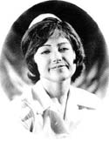
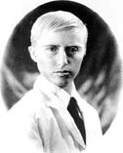
Cindy Sherman
Untitled Film Still #244
Cindy Sherman
Untitled Film Still #244A

Slide 44
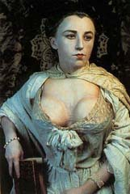
Cindy Sherman
History Portrait. Old Masters
Untitled 183

Slide 45
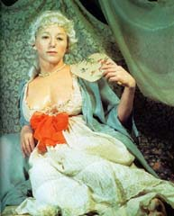
Cindy Sherman
History Portrait. Old Masters
Untitled 193

Slide 46
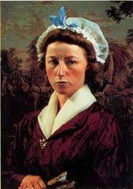
Cindy Sherman
History Portrait. Old Masters
Untitled 199

Slide 47
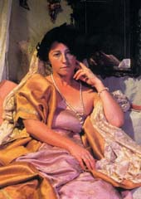
Cindy Sherman
History Portrait. Old Masters
Untitled 204

Slide 48
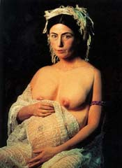
Cindy Sherman
History Portrait. Old Masters
Untitled 205

Slide 49
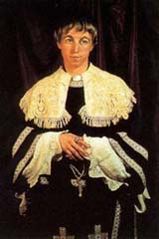
Cindy Sherman
History Portrait. Old Masters
Untitled 215

Slide 50
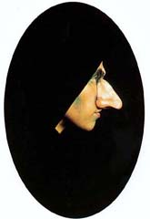
Cindy Sherman
History Portrait. Old Masters
Untitled 219

Slide 51

Cindy Sherman
History Portrait. Old Masters
Untitled 222

Slide 52

Cindy Sherman
History Portrait. Old Masters
Untitled 225

Slide 53
Cindy Sherman
centerfolds

Slide 54

Cindy Sherman
Untitled 96

Slide 55

Cindy Sherman
Untitled 86

Slide 56

Cindy Sherman
Untitled 87

Slide 57

Cindy Sherman
Untitled 88

Slide 58

Cindy Sherman
Untitled 90

Slide 59

Cindy Sherman
Untitled 92

Slide 60

Cindy Sherman
Untitled 93

Slide 61

Cindy Sherman
Untitled 96

