Slide 1
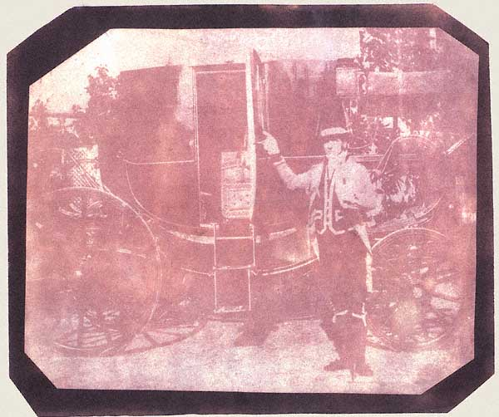
William Henry Fox Talbot: The Footman.
The first photograph on paper of a human figure, 1840

Slide 2
the beginning images

Slide 3
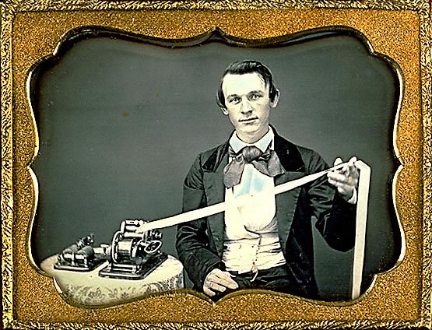
Unidentified Photographer (U.S.): The Telegrapher
Daguerreotype, Quarter-plate size ( 3.25 x 4.25 inches), circa 1853
The telegraph apparatus shown consists of a key used for transmission (left) and an embossing telegraph receiver to the right. There was likely a message embossed in the dots and dashes of Morse Code on the paper strip held by the subject of this portrait, but we can only guess at what it might have said.

Slide 4
The telegraph, photography, railroad and the steamship were considered the wonders of the modern world in the middle of the 19th century. These inventions triggered revolutionary changes in society. This daguerreotype shows a young man proud of being in the technological vanguard of his day--as one of the first people to be "wired" through history's first electronic communications network.
As an occupational daguerreotype, this image provides us with more information than an ordinary portrait. Its brilliant clarity and dynamic pose communicate something of importance to the sitter, something he wanted people in the future to know about him. And the magic works: the daguerreotype vanquishes the separation of 150 years as effectively as the telegraph conquered the physical distance of people separated by a continent. "A Sender of Messages!" is the message he sends... and the message we receive.

Slide 5
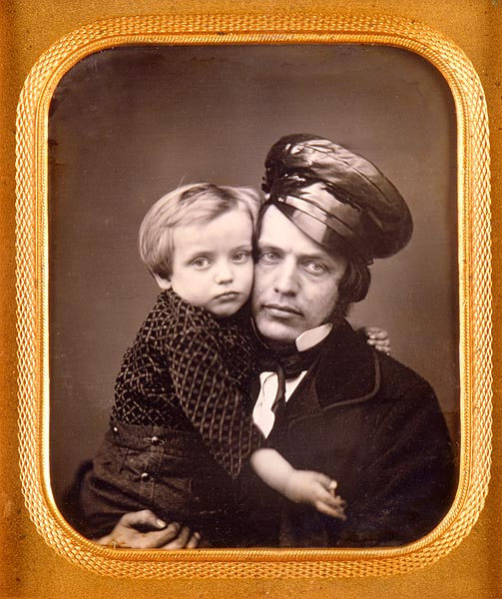
Unidentified Photographer (U.S.): "Uncle Geo. & Gus"
Daguerreotype, sixth-plate size ( 2.75 x 3.25 inches), circa 1853
"A portrait of such tremendous sensitivity that it reaches out to us with both the power of art and that unique power of photography which constantly reminds us that what we see actually happened."

Slide 6
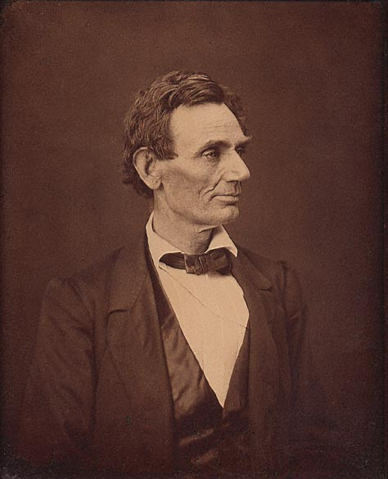
Alexander Hesler (Springfield, Illinois): Abraham Lincoln
Albumen print, 6.5 x 8.5 inches, 1860
One of three photographs taken by Hesler during a sitting June 3, while Lincoln was campaigning for the presidency. Of these portraits Lincoln said, "That looks better and expresses me better than any I have ever seen; if it pleases the people I am satisfied.”

Slide 7
Lincoln's law partner, William Herndon, was more specific about this noble pose: "There is a peculiar curve of the lower lip, the lone mole on the right cheek, and a pose of the head so essentially Lincolnian; no other artist has ever caught it."
This print was made late in the nineteenth century by George B. Ayres. The negative for this image survives in the Smithsonian Institution, although it is now shattered

Slide 8
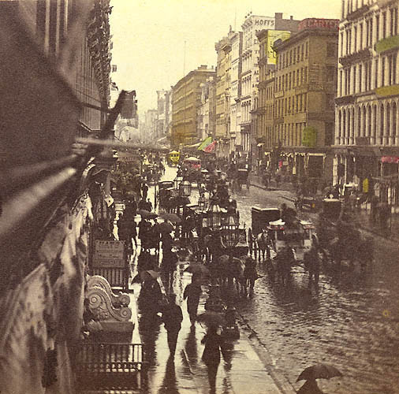
Edward Anthony (U.S., 1819-1888): "Broadway on a Rainy Day," from Anthony's Instantaneous Views
Stereoscopic albumen photograph on card, approx. 3.5 x 7 inches overall, 1860
Until the first "instantaneous" images (those made in a fraction of a second), photographs of cities showed the streets seemingly devoid of traffic, almost eerily empty. Anthony's Instantaneous series combined the stunning 3-D illusion of stereoscopic photography with the novelty of stop-motion in a technical tour-de-force--the virtual reality of its day.

Slide 9
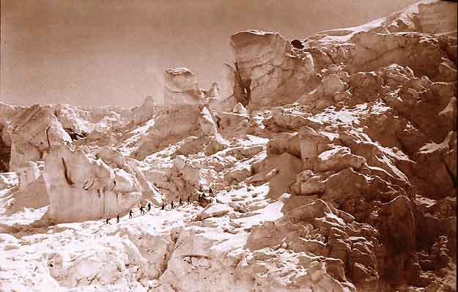
Bisson Frères (Louis-Auguste Bisson [France, 1814-1876] & Auguste-Rosalie Bisson [France, 1826-1900]): Glacier des Bossons, Savoie.
Albumen print 9.5 x 15.5 inches, circa 1860

Slide 10
The Bisson Brothers were among the best-known European photographers of the 1850s and 1860s. Their most famous body of work is comprised of the high-altitude photographs they made in the Alps during the climbing seasons of 1859-1862. In 1860, on the occasion of the reunion of Savoy with France, and accompanied by Napoleon III and the Empress, the Bissons went to Chamonix to attempt the ascent of Mont-Blanc. They failed to reach the summit but the large glass negatives they produced during the climb were the basis of an album of twenty-four superb Alpine views.
Despite the arduous conditions, the Bissons captured this masterful scene of an epic struggle by men intent on conquering nature--set against a magnificent landscape.
This large format print is identified by both a blindstamp ("FBF" in a circle) and an ink stamp ("Bisson frères"). It was almost certainly made prior to 1864, when the Bissons' partnership ended and Louis-Auguste retired from photography.

Slide 11
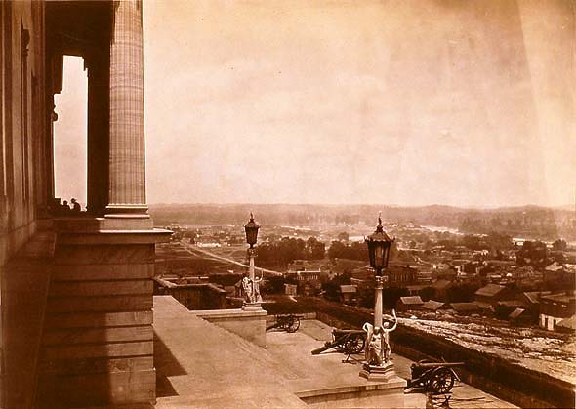
George N. Barnard (U.S., 1819-1902): Nashville From the Capitol
Albumen Print, approx. 11 x 14 inches, 1864

Slide 12
This image appears, in a variant form, as Plate 3 of Barnard's Photographic Views of Sherman's Campaign, an album of 61 albumen prints published by Barnard in 1866.
Barnard started his career as a daguerreotypist in New York state and worked for Mathew Brady early in the Civil War. He became an official photographer of the Military Division of the Mississippi in time to record the march of Sherman's Army from Tennessee through Georgia to the sea, and then north through the Carolinas. To the North, it was a brilliant, bold and decisive military campaign--a triumph worthy of the monumental commemorative album Barnard issued after the war. To Southerners, Sherman's campaign was vicious, bloody, and destructive.
The Tennessee state capitol at Nashville was under construction at the outbreak of the Civil War. Barnard's descriptive text explains...
The location selected [for the building] was a commanding elevation in the center of the city, which places the base of the capitol somewhat higher than the roofs of the majority of the buildings near. During the siege of [Nashville] by General Breckinridge in 1862, the capitol was strongly fortified by J. St. C. Morton, of the Engineer Corps, U.S.A., and converted into the citadel of the fortifications above the city... This edifice was the only State capitol that was fortified during the late war.
Barnard's photograph, with its row of threatening cannons interspersed by decorative statuary groups, shows the capitol as a great stone sentry looming over the rooftops of the rebel city. The tiny silhouetted figures near the columns enhance the monumentality of this statehouse-turned-fortress.

Slide 13
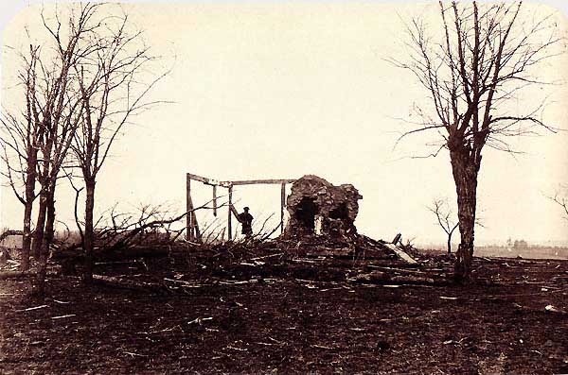
David B. Woodbury (U.S., d. 1866 ): "Mrs. Henry's House at Bull Run"
Albumen print, 5.75 x 9 inches, 1861

Slide 14
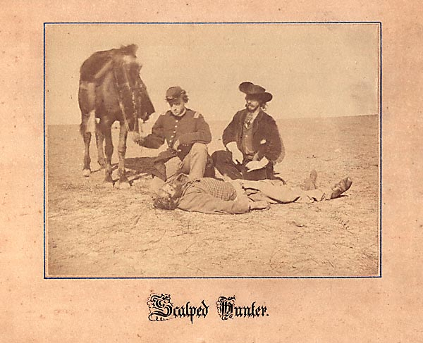
Will Soule (U.S., 1836-1908): Scalped Hunter Near Fort Dodge, Kansas
Albumen print on calligraphic mount, 6 x 7.75 inches, December 7, 1868

Slide 15
Will Soule was a young Civil War veteran who took a job on the frontier and made an important series of Native American portraits at Fort Sill, Oklahoma from 1869 to 1874. This dramatic photograph depicts an incident from the 1868 warfare between the U.S. Seventh Cavalry under the command of General Alfred Sully and the Cheyenne and Arapaho tribes. That fighting led to the establishment of Fort Sill.
This early news photograph was circulated nationally in the form of a wood engraving in Harper's Weekly for January 16, 1869. The accompanying caption reads:
On December 7 Mr. Ralph Morrison, a hunter, was murdered and scalped by the Cheyenne within a mile of Fort Dodge. Wm. S. Soule, an amateur photographer [and] chief clerk in Tappin's Trading Company, took the picture. The officer is Lieutenant Reade, 3rd Infantry. John O. Austin, Chief of scouts, is on the right. The photo was taken within an hour after the killing.
On leaving Fort Sill, Will Soule departed from Indian Territory for Boston, where his brother John P. Soule had a flourishing business as a publisher of photographs.

Slide 16
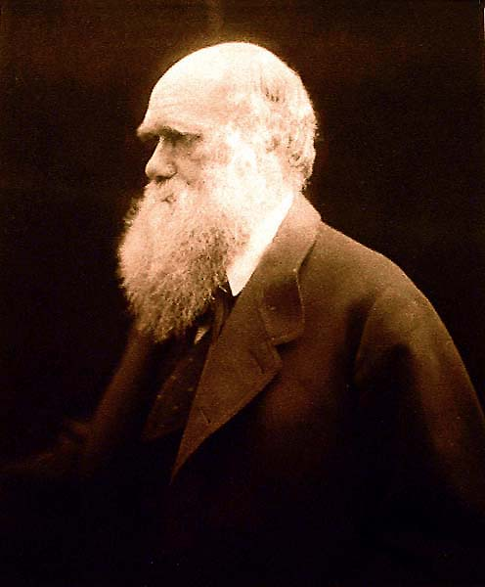
Julia Margaret Cameron (England, 1815-1879): Charles Darwin
Albumen print, 11.25 x 9.5 inches, 1868
On mount: blindstamp of Messrs. Colnaghi (Mrs. Cameron's printsellers) and a facsimile inscription in Darwin's hand, "I like this Photograph very much better than any other which has been taken of me.
Ch. Darwin"

Slide 17
Darwin and his family went to Freshwater, Isle of Wight, for a long summer holiday in 1868. Mrs. Cameron, who lived and worked at Freshwater, obtained a sitting from the great naturalist. Helmut Gernsheim describes their encounter in Julia Margaret Cameron: Her Life and Photographic Work (Aperture, New York: 1975):
She received the whole family with open-hearted kindness and hospitality, and Darwin always retained a warm feeling of friendship for her. When they left she came to see them off, loading them with presents of photographs. Moved, Darwin said: "Mrs. Cameron, there are sixteen people in this house, all in love with you." Darwin paid her for her portraits of him, and as the Camerons had by that time lost a great deal of money through the continued failure of the coffee crop, she gladly accepted payment and ran boasting to her husband, "Look, Charles, what a lot of money!”

Slide 18
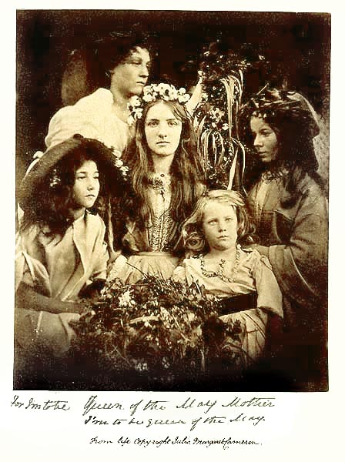
Julia Margaret Cameron (England, 1815-1879): "For I'm to be Queen of the May Mother, I'm to be Queen of the May."
Albumen print, 4.5 x 4.75 inches, 1866 (?)

Slide 19
In Julia Margaret Cameron's Women (The Art Institute of Chicago/Yale University Press: 1998), Sylvia Wolf writes:
Packed with five figures and a profusion of flowers, the image is tightly composed, with slight vignetting to emphasize the circular composition around the central figure. The photograph is obviously staged... The zombielike state with which each sitter maintains her position makes this a somber occasion, not the joyful one the picture's title suggests.
...A tangle of leaves, twigs, and berries in the foreground and wilting flowers strung around the models' necks, or tucked behind their ears, add an element of disorder and decay that is reminiscent of the vanitas theme of a Dutch still-life painting--everything a bit ripe and overdone, as a reminder of mortality. What should be a photograph about fertility and abundance, about budding youth and potential, has instead a frozen sadness to it. This theatrical excess is precisely what makes the picture strangely powerful and touching.

Slide 20
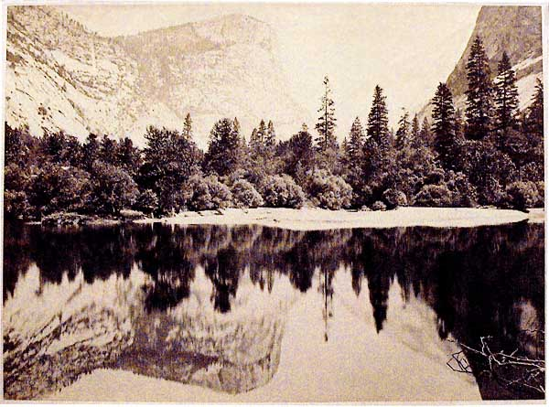
Carleton E. Watkins (U.S., 1829-1916): Mirror Lake, Yosemite
Albumen print, 8 x 12 inches, 1866

Slide 21
A perfectly symmetrical composition, save for the branches included in the right foreground. This detail heightens the three-dimensional quality of the photograph, and also serves to anchor the image visually--helping the viewer to sort foreground from background, reflection from horizon.
Watkins made this image with a camera fitted for wet-plate negatives, 9-1/2 x 13 inches. During his 1866 expedition into the Yosemite Valley, he also made negatives in three other formats: mammoth plates (18x 22 inches), stereoscopic views, and full-plates (6.5 x 8.5 inches) intended for publication in The Yosemite Book. Watkins was in Yosemite with a California state geological party, led in the field by Clarence King.
With four cameras, field darkroom equipment, and fragile glass plates to transport along rugged trails, Watkins needed to work with assistants. Peter Palmquist, in Carleton E. Watkins: Photographer of the American West [University of New Mexico Press, Albuquerque: 1983] suggests that one of the assistants on this trip may have been George Fiske, who later became a great photographer of Yosemite in his own right.

Slide 22
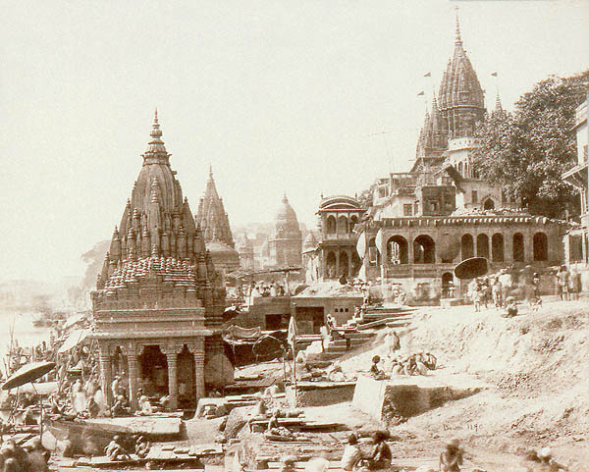
Samuel Bourne (England, 1834-1912): "Vishnu Pud and Other Temples near the Burning Gat, Benares."
Albumen print, approximately 8-3/4 x 11 inches, circa 1865.

Slide 23
These temples are located on the banks of the Ganges in the holy city of the Hindus, now called Varanasi. The ghats are steps to the river, the "burning ghat" being a place for cremations. The umbrellas shelter holy men who help pilgrims with rituals.
This beautifully-composed photograph, teeming with activity, is certainly among Bourne's finest and most observant works. Another copy, in the collection of the International Museum of Photography at George Eastman House, was published in Masters of Early Travel Photography by Rainer Fabian and Hans-Christian Adam (Vendome Press, New York: 1983) and also appeared on the front of the book's dust-jacket. A print of the image in the collection of the Victoria and Albert Museum was published in The Golden Age of British Photography, 1839-1900 (Aperture: 1984).

Slide 24
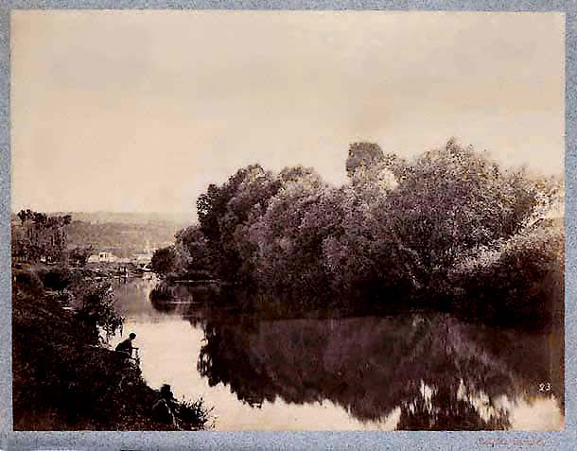
Achille Quinet (France): Etude d'Après Nature (Nature Study) #23
Albumen print, approximately 7.5 x 9.75 inches, circa 1875

Slide 25
In response to those who refuse to accept photography as an artistic expression, M. Quinet, selecting the simplest of subjects--a corner of woods or hedgerows, a fine river view, etc.--choosing his hour of light, and portraying with great finesse a sense of light even among the shadows, has produced photographs decidedly deserving of the term "artistic studies."
--Alphonse Davanne, Bulletin de la Societe française de photographie, 1876

Slide 26
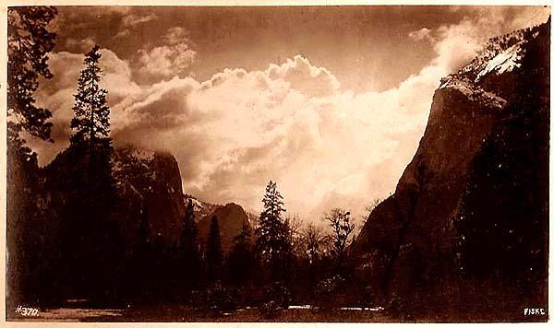
George Fiske (U.S., 1835-1918): "Spirit Land. Up the Valley."
Albumen print,4.5 x 7.5 inches, circa 1880

Slide 27
George Fiske was the first photographer to be a year-round resident of Yosemite; this is arguably the most dramatic of his many superb studies of that spectacular valley.
To Ansel Adams--himself a longtime resident of Yosemite Valley--the photographs of George Fiske have special meaning. For as a young man in the 1920s, he made many prints from the Fiske negatives acquired by the Yosemite Company from the estate. These represented only a part of Fiske's lifework, for in 1904 three-quarters of his negatives, his cameras, his lenses and a large part of his stock of prints were destroyed in a fire that consumed his house and studio. In the thirties, Adams became much concerned with the safety of the remaining negatives, for they were carelessly kept in the attic of the company's sawmill. His suggestion that they be stored in the fireproof basement of the new museum building was ignored. In 1943 the sawmill burned to the ground; all that were left of Fiske's negatives were destroyed. "If that hadn't happened," Adams stated, "Fiske could have been revealed today, I firmly believe, as a top photographer, a top interpretive photographer. I really can't get excited at Watkins and Muybridge--I do get excited at Fiske. I think he had the better eye."

Slide 28
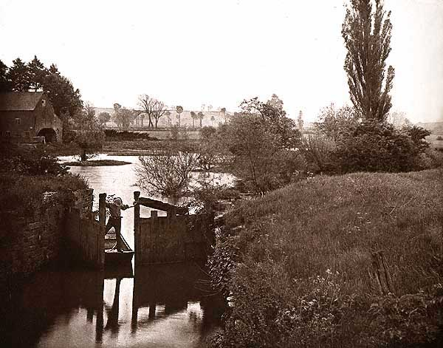
Dr. James Leon Williams (United States, born 1852): "The Old Lock at Welford"
Photogravure, 7.25 x 9.5 inches, 1892

Slide 29
Williams was a dentist and a scholar, the inventor of modern dentures, and a photographer of considerable talent. He was one of the first American photographers to grasp the artistic potential of the photogravure process. Williams' work follows the precepts of the "Naturalistic" school of photography founded by Peter Henry Emerson. Emerson advised photographers to keep the central subject of the composition sharp, allowing the focus to drop off in the background. The resulting atmospheric effect was thought to be more "natural," because Emerson believed the human eye could concentrate its focus on only a single plane.

Slide 30
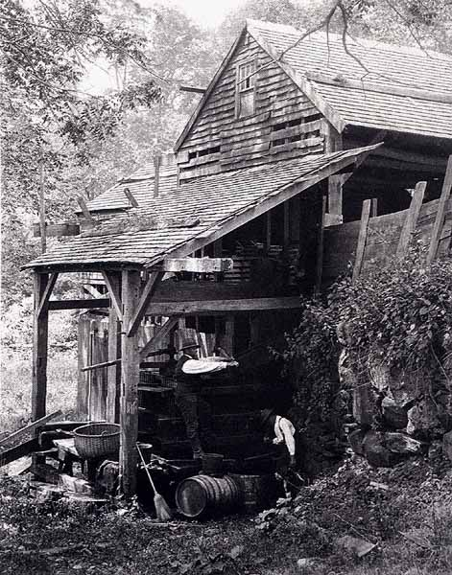
Robert S. Redfield (U.S., 1849-1923): "A Cider Mill Near Lake Warramaug, Connecticut"
Platinum print, 9.6 x 7.5 inches, June 9, 1890

Slide 31
Redfield was President of the Photographic Society of Philadelphia, a founding member of the Photo-Secession, and a leader in the late-nineteenth century campaign to have photography recognized as a fine art.
This photograph--with the textures of leaves, shingles, rocks, and a fine woven basket all skillfully rendered--shows the remarkable range of tones and delicate shadow details that are the hallmarks of a great platinum print. It is from Redfield's personal album.

Slide 32
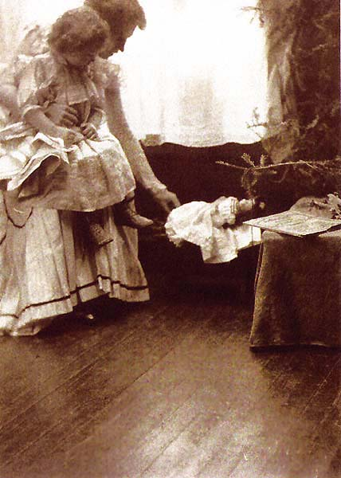
Gertrude Kasebier (U.S., 1852-1934): A Christmas Scene
Platinum print, 8 x 6 inches, circa 1904

Slide 33
Like Julia Margaret Cameron, Kasebier took up photography only after her children were grown. She was a founding member of the Photo-Secession, having earlier received recognition from overseas by becoming the first woman elected to The Linked Ring. Kasebier remained in the first ranks of creative photographers and in 1916 helped to found the Pictorialist Photographers of America.
This seldom-seen image utilizes many of the signature techniques of Secessionist photography, including lighting that creates an atmospheric quality and defines space. In depicting the figures silhouetted against a brilliant light, Kasebier is making use of the platinum print's capacity to render subtle tones within shadows. This technique is reminiscent of her most famous photograph, another mother-and-child composition called "Blessed Art Thou Among Women."

Slide 34
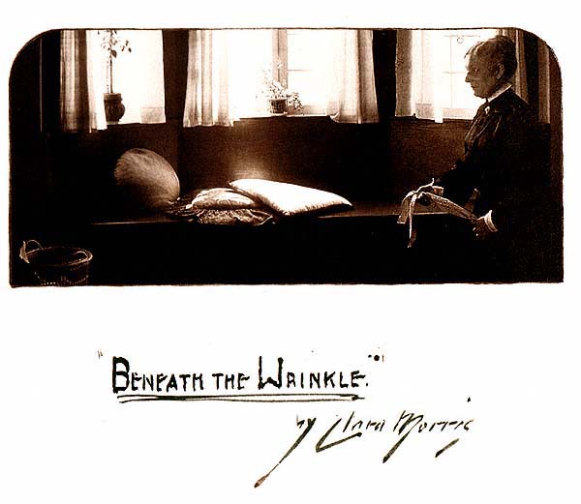
Clarence H. White (U.S., 1871-1925): "What Was It Trying To Remind Me Of?"
Title page design, collodion print and ink, 14 x 10.75 inches, 1903

Slide 35
From a unique portfolio by the great Photo-Secessionist photographer and teacher, containing six images illustrating the short story "Beneath the Wrinkle." Three of the images were published along with Clara Morris's story in the February 1904 issue of McClure's. This distinctive title page design by White, depicting the story's prologue, was not included in McClure's, and remained unpublished until 1980. Another image from the portfolio was published along with the story and also appeared in Alfred Stieglitz's famed magazine, Camera Work.
The portfolio was produced at the time when White was leaving Newark, Ohio to become a full-time photographer and teacher in New York, and thus represents an important commission in his career.
In this image, the narrator is shown holding an old, faded ribbon. In the story, the narrator notices a brilliant streak of color hidden inside a wrinkle in the fabric... reminding her of an episode that began half a century before.

Slide 36
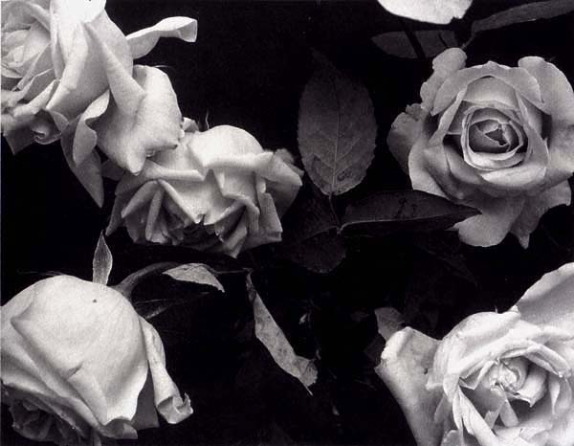
Edwin Hale Lincoln (U.S., 1848-1938): Roses
Platinum print, 7.5 x 9.5 inches, circa 1915

Slide 37
While Edwin Hale Lincoln was not affiliated with the powerful Photo-Secession, he had strong ties to the American Arts & Crafts movement; his photographs were featured in Gustav Stickley's influential magazine, The Craftsman. Lincoln was a champion of "straight" photography at a time when gauzy pictorialism was in vogue, and this magnificent platinum print is a splendid example of his highly sophisticated and very modern vision.
The flowers are not shown in a bouquet, nor do they appear to have been arranged for the camera or even touched by human hands. There is a random, serendipitous quality to this photograph--the intermingling of blossoms and leaves, the few glistening drops of moisture, and the way the composition extends to the edges of the print.

Slide 38
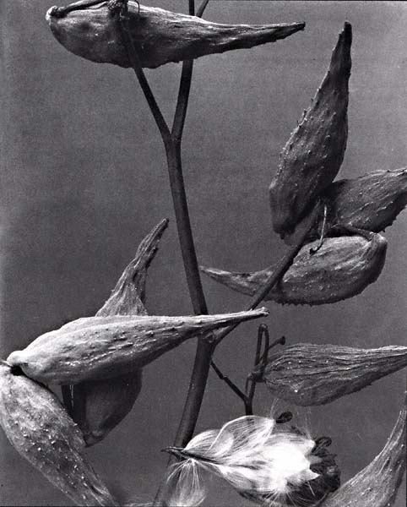
Edwin Hale Lincoln (U.S., 1848-1938): "Asclepias syrica. Fruit of Common Milkweed"
Platinum print, 9.25 x 7.25 inches, 1906
Lincoln included this photograph in his self-published Wild Flowers of New England (produced in several editions; by 1914, the publication was comprised of 400 mounted platinum prints). While the plant at this stage is certainly not a flower, Lincoln has used it to create a dazzling visual tone-poem of shapes and shadows, lines and textures. As a purely modern photograph, it stands up well in comparison to the classic works of Edward Weston a quarter-century later.

Slide 39
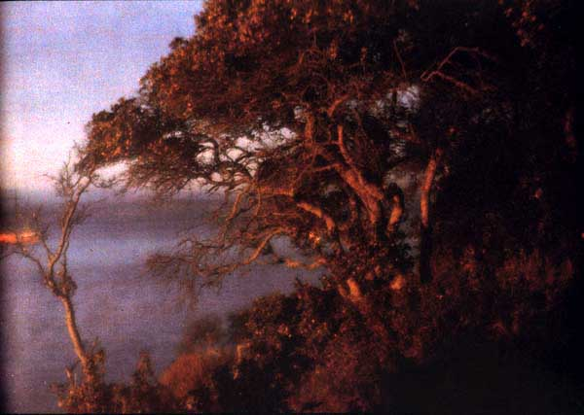
Francis Bruguiere (U.S., 1879-1945): The Golden Gate
Autochrome, 5 x 7 inches, circa 1915

Slide 40
Bruguiere was a California member of the Photo-Secession who moved to New York and became a well-known theatrical producer. He created photographs in the Surrealist vein in the 1920s and later moved to England.
Autochromes are natural-color transparencies on glass, made on specially-prepared plates. The process was the first system of color photography to become a commercial success. It uses millions of grains of potato starch dyed in primary colors as light filters, creating a pointillist effect. Autochrome plates were invented by the Lumiere Brothers of France and marketed by their firm beginning in 1907. The plates were immediately popular with pictorialist photographers.
This glowing, soft-focus image was formerly in the collection of the photographer Immogen Cunningham.

Slide 41
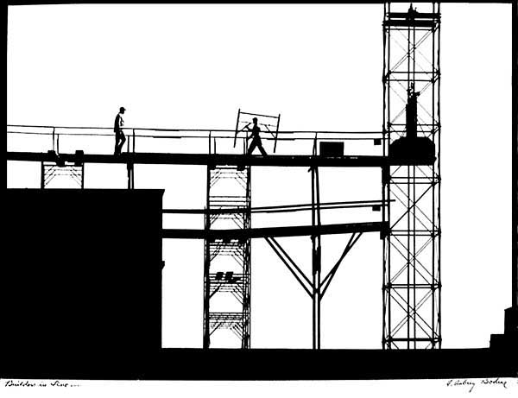
A. Aubrey Bodine (U.S., 1906-1970): "Builders in Line"
Gelatin Silver Print, 13 x 18 inches, circa 1961.

Slide 42
A. Aubrey Bodine had an illustrious half-century career as a photographer for the Baltimore Sun newspaper. A true American original, he combined reportage with the creative eye of an artist-- achieving results that are still striking today. Bodine's work includes award-winning pictorialist images as well as "straight" story-telling photojournalism. His images struck a chord with the public because they are more than narratives or illustrations alone -- they are also creative works of great originality.
Bodine was one of the best-known and most successful participants in the photographic salons (juried competitions) popular around the world during most of the 20th century. In 1961, he submitted this high-gloss, high-contrast exhibition print to the Rochester International Salon of Photography and to the Chicago International Exhibition of Photography. This image was also sent to exhibits in Seattle; Teaneck, New Jersey; and Alba, Italy.
A. Aubrey Bodine specialized in photographing the scenes and people of the Chesapeake Bay region, although the exact location of this scene is not known. His daughter Jennifer notes,"My guess would be that it is located somewhere in Baltimore... but if he drove down a highway anywhere and saw an image he liked, he would pull over to the side of the road and haul out his gear. Travels with Daddy could always bring the unexpected."
It is just that spirit of serendipity that makes A. Aubrey Bodine's work such a delight.

Slide 43
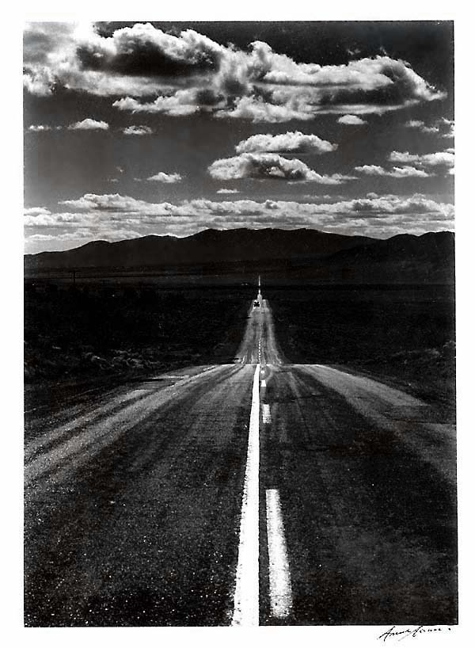
Speaking volumes about the wide open spaces of the American West... and about the road ahead... this image shows a surprising side to Ansel Adams' works. But Adams' career was filled with fresh visual surprises--insights that combined to make him the most famous photographer of the twentieth century.
This seldom-seen image is part of Adams' Hasselblad Series, and he annotated and signed it on the back for the present owner in 1979.
Ansel Adams (U.S., 1902-1984): Road, Nevada Desert
Silver-gelatine print, 7.5 x 9.5 inches, circa 1960

Slide 44
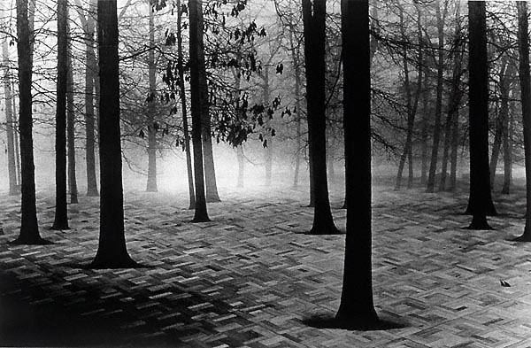
Scott Mutter (U.S., b. 1944): Untitled (Forest)
Gelatine-Silver Print Photomontage, 11 x 14 inches, 1975

Slide 45
While others use the techniques of photomontage for shock effect, Mutter creates worlds that can best be described as "hyper-realistic." Many of his images give the viewer a sense of deja-vu; we feel as if we must have been to these places, that they are as real as they are magical.
Always on the edge of Mutter's works is an eerie, apocalyptic feeling. This aura comes from Mutter's interest in the two forces that act upon human beings: the natural world and the world that humans have built around themselves. Mutter achieves the element of surprise by melting the antithetical images together in a realistic way, so that the eye accepts what the head doubts.
--April Austin, Christian Science Monitor
"Art is no idle thing," declares Scott Mutter, "people want to see something and be held in wonder."

Slide 46
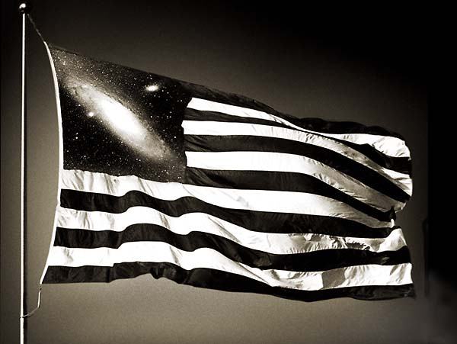
Untitled (Flag). Scott Mutter: A More Perfect World

Slide 47
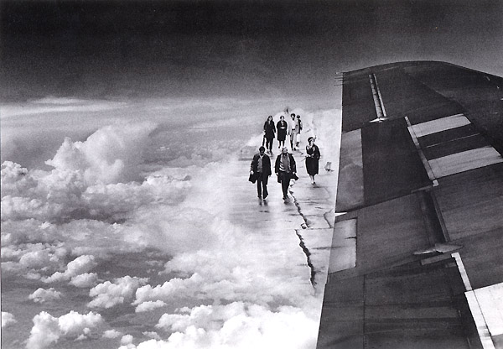
Time Travelers. Scott Mutter: A More Perfect World

Slide 48
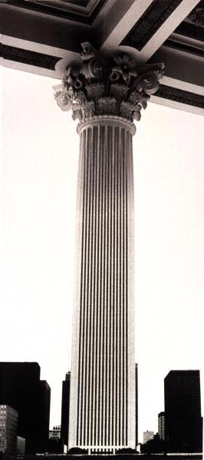
Untitled (Column). Scott Mutter: A More Perfect World

Slide 49
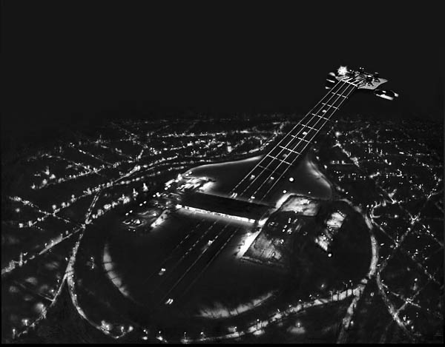
Untitled (Guitar). Scott Mutter: A More Perfect World

Slide 50
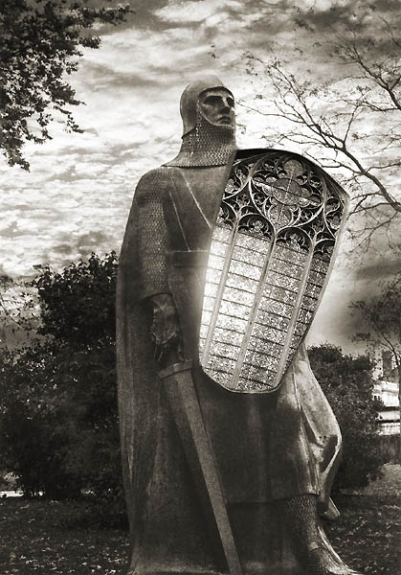
Untitled (Knight).
Scott Mutter: A More Perfect World

Slide 51
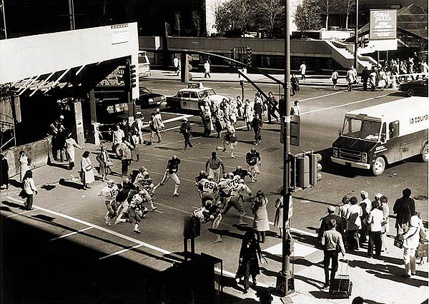
First and 10. Scott Mutter: A More Perfect World

Slide 52
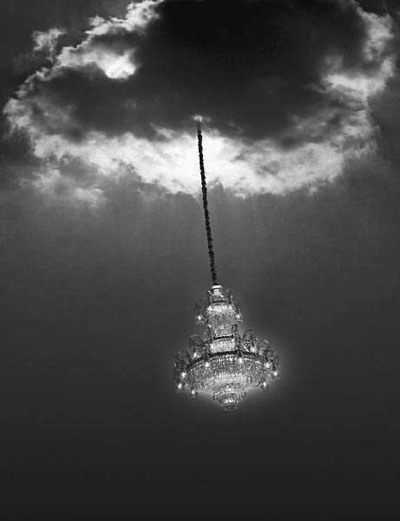
Untitled (Chandelier).
Scott Mutter: A More Perfect World

Slide 53
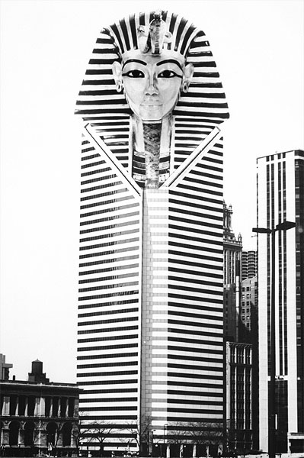
Untitled (King Tut).
Scott Mutter: A More Perfect World

Slide 54
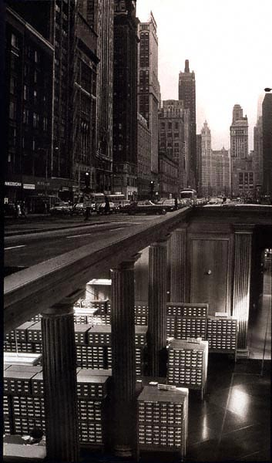
Untitled (Library).
Scott Mutter: A More Perfect World

Slide 55
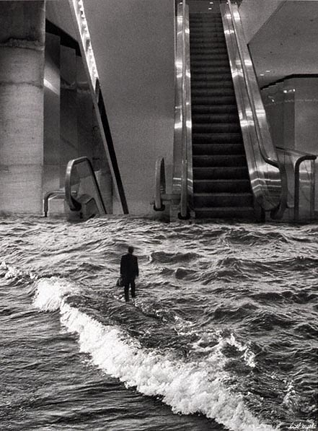
Untitled (Escalator).
Scott Mutter: A More Perfect World

Slide 56
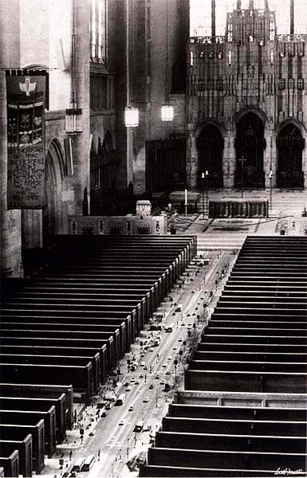
Untitled (Church Aisle).
Scott Mutter: A More Perfect World

Slide 57
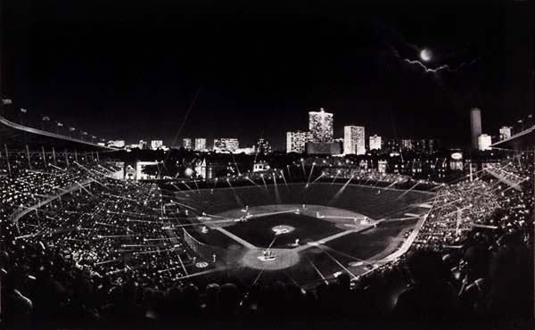
Wrigley Field, Chicago. Scott Mutter: A More Perfect World

Slide 58
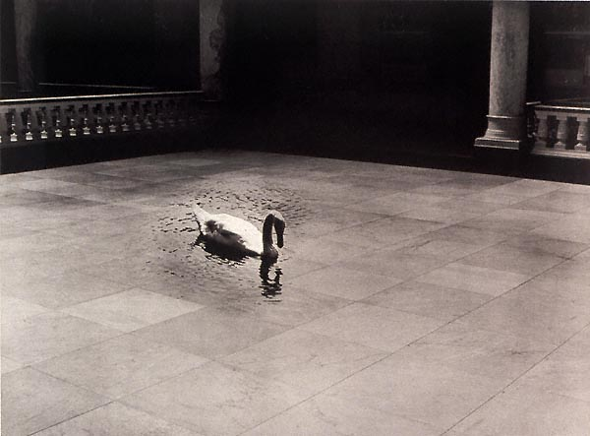
Untitled (Swan). Scott Mutter: A More Perfect World

Slide 59
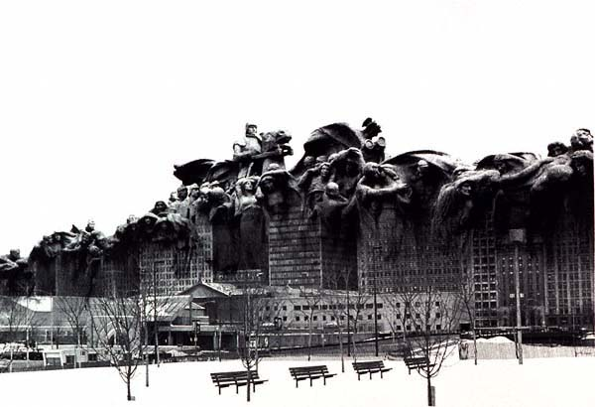
Untitled (Fountain of Time). Scott Mutter: A More Perfect World

Slide 60
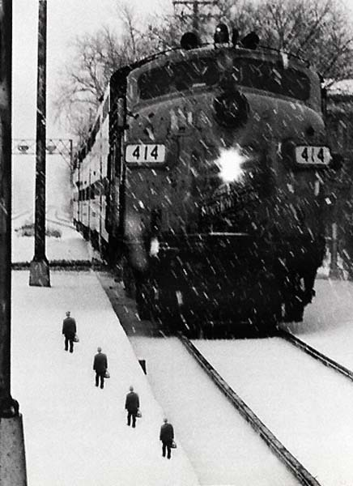
Untitled (Train).
Scott Mutter: A More Perfect World

Slide 61
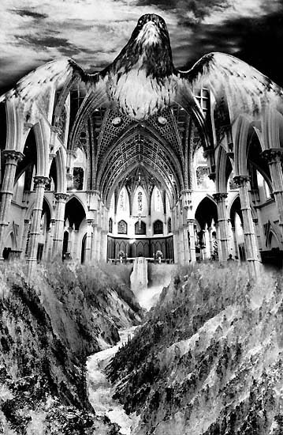
Untitled (Eagle). Scott Mutter: A More Perfect World

Slide 62
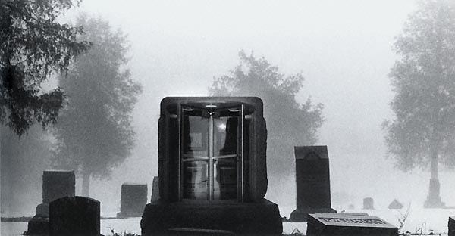
Untitled (Revolving Door). Scott Mutter: A More Perfect World

Slide 63
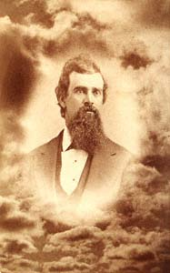
Three simple techniques account for the majority of manipulated photographs ever made. Composite photographs, also called photomontages ( below, left) combine images from multiple sources into a single picture. Multiple exposures (below, center) generally are produced on a single negative by a single camera.
Photo collages (below, right) combine pieces physically cut out of various photographs into a single new picture, sometimes with details changed or added by an artist.
Unidentified photographer (U.S.): Bust portrait of a man in clouds. Albumen cabinet card, circa 1870.

Slide 64
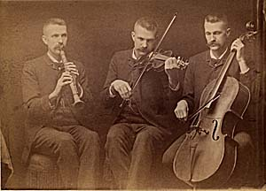
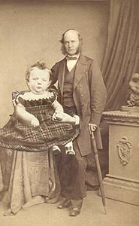
Abel J. Whalen (active Michigan, 1862-1897): A One-Man Trio. Albumen print cabinet card, circa 1895
Unidentified artist: The Giant Baby. Photocollage on a carte de visite portrait by Bassano of London, circa 1865

Slide 65
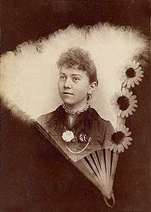
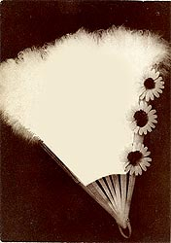
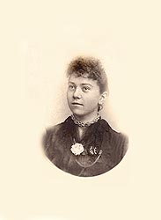
Composites (Photomontages)
Beginning in England with the works of Oscar G. Rejlander and Henry Peach Robinson, composites were used to make ambitious large-scale exhibition photographs as early as the 1850s. The techniques used were soon employed around the world. Here are two examples reconstructing the methods used for making photomontages.
The photographer begins by making a print of the fan, covering the central area to leave it blank.
Before the photograph is fixed, the portrait negative is put in place and the print is exposed again.

Slide 66
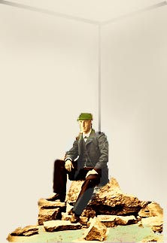
How to Visit Niagara Falls
Without Leaving Home
With the advent of dry plates in the 1880s, it became possible to capture water scenes with dramatic breaking waves. Here, an unknown photographer has leveraged that achievement -- either by taking such a negative or by purchasing one -- and then using it as a background for studio portraits. While it seems likely that this image was created near Niagara Falls, it is possible that the studio portrait could have been made anywhere, and then combined into a personalized souvenir. The process begins by taking an ordinary portrait, perhaps in a corner of the studio with natural-looking rocks in the foreground.

Slide 67
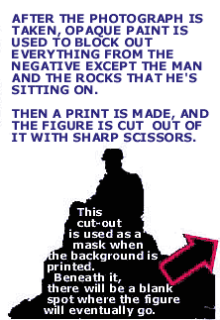


Slide 68


Next, the negative showing the man on the rocks is printed onto the same piece of photographic paper as the background. Since everything else is covered with opaque paint, only the figure will print -- fitting neatly into the hole left for it by the mask.

Slide 69

Ghosts. Do You Believe?
The first ghosts in photographs were the result of accidents. During a long exposure--such as those required in photography's infancy--a person who stood still would register as clearly as a building. But a person who moved out of camera range after only a portion of the exposure was completed would instead appear as a see-through blur. It happened with the lamplighter in this detail from a photograph by the London Stereoscopic Company.
To the right, another figure can be seen--a gawker who did not stay around long enough to be immortalized by the camera.
The Vanishing Lamplighter

Slide 70

The Ghost in the Stereoscope
In his landmark 1856 book on 3-D photography, The Stereoscope, the optical scientist Sir David Brewster suggested:
For the purpose of amusement, the photographer may carry us even into the realms of the supernatural. His art enables him to give a spiritual appearance to one or more of his figures, and to exhibit them as "thin air" amid the solid realities of the stereoscopic picture.
The first firm to mass-market 3-D images, the London Stereoscopic Company, published views (like the one above), entitled "The Ghost in the Stereoscope." Produced in the late 1850s, they often carry a printed acknowledgement of Brewster's contribution.

Slide 71

Unidentified Photographer (U.S.)
Woman with Daisies and Spirit
Tintype, Sixth-plate ( 2.75 x 3.25 inches )
circa 1875
This beautifully-executed image is remarkable in several ways. The posing is dramatic, making the composition compelling for more than the "special effect" of the ghost. From a technical standpoint, this is a highly unusual photograph. Tintypes were made directly on a painted metal plate, without the use of a negative, thus eliminating the possibility of most forms of darkroom manipulation. In addition, the image needed to be exposed and developed before the sensitive coating on the plate had time to dry out. For that reason, the woman who is being "haunted" must have been a knowing participant in the production of this picture. She would have been required to hold her position for an exposure lasting several seconds; part of the way through that exposure, the shrouded figure would have stepped out of the frame.

Slide 72

Phillips Bros. (A. H. Phillips and A. T. Phillips), Pontiac, Michigan
Man Reading with Female Spirit Behind
Albumen carte de visite, 2.25 x 4 inches
circa 1870
A mysterious image, quite unlike other spirit photographs in the same format. How was it done? The spirit appears to be part of the backdrop, and that may be an important clue. In the book Photographic Amusements (first published in 1896) Walter E. Woodbury offered several different techniques for making spirit photographs. One involved painting a picture of a ghostly figure with "fluorescent substances, such as bisulphate of quinine... This compound, although almost invisible to the eye, photographs nearly black. If a white piece of paper be painted with the substance, except on certain parts, the latter only will appear white in the picture."

Slide 73

Frederick A. Hudson (England)
Mr. Raby with the Spirits "Countess," "James Lombard," "Tommy," and the Spirit of Mr. Wootton's Mother.
Albumen Print, 3.5 x 4 inches
circa 1875
Inscribed in ink on the verso:
Obtained by Messrs. Raby Wootton & Rutherford at Hudson's Studio.
At a Seance at Mr. Wootton's the spirits desired him to go to Hudson's promising they would try to produce their likeness.
Mr. W. did so, accompanied by his friends. The gentlemen operated [i.e., took the photograph] themselves without allowing Hudson to take any part in the manipulations. The result was exactly as the spirits had told beforehand it would be. Mr. Raby sat and the spirits "Countess," "James Lombard," "Tommy," and Mr. Wootton's mother appeared when the plate was developed.

Slide 74
Frederick A. Hudson was England's first spirit photographer. His earliest results were obtained in 1872. The editor of the British Journal of Photography investigated the following year, bringing his own plates and chemicals, and could not come up with an explanation. Dr. Alfred Russel Wallace, who shares credit with Charles Darwin for the discovery of evolution, was a client of Hudson and obtained two different photographs showing his deceased mother.
Hudson was occasionally caught in the act of faking his images, and was even found dressing up to play the role of the ghost. Nevertheless, he "became the best known British psychic photographer and was known for producing supernormal extras on his plates under the closest of scrutiny." (Cyril Permutt, Beyond the Spectrum [Cambridge: Patrick Stephens, 1983], p. 17. )

Slide 75

F. M. Parkes (England)
"Mrs. Collins & Her Husband's Father, Recognized by Several."
Albumen carte de visite, 2 x 3.8 inches
1875
Parkes was one of the first spirit photographers in Britain, beginning his work in 1872, the same year as Frederick Hudson. His earliest images were made in partnership with the proprietor of a restaurant, who served as medium. Following directions from the spirits, Parkes required that photographic plates be placed in his control in the darkroom before they were inserted in the camera--so they could be "magnetised." If that aroused suspicions, Parkes tried to compensate by cutting a hole in his darkroom wall so that his patrons could witness the processing of the negative.

Slide 76
The vertical line running through this photograph is caused by a break in the glass negative. Perhaps this was intended as a visual distraction, or served as evidence of paranormal vibrations.
Mrs. Collins' husband was an amateur photographer, who wrote a letter to the spiritualist journal Human Nature in which he hedges a little on the accuracy of this spirit likeness of his father (click here for the text). Judging by appearances alone, the late Mr. Collins could have served as the model for the Edvard Munch painting The Scream.

Slide 77

Frederick A. Hudson (England)
Lady Helena Newenham and the Spirit of Her Daughter
Albumen carte de visite, 2.25 x 4 inches
June 4, 1872
Hudson had a studio at 177 Holloway Road, London. He is credited with producing the first spirit photograph made in Britain on March 4, 1872, just three months before this image was made.
Inscription on verso:
"June 4th 1872/Mrs. Olive (?) and Mr. Herne, Mediums. Lady Helena Newenham and the spirit of her daughter."
Frank Herne was a prominent medium who began giving seances in January, 1869. Witnesses reported he was capable of levitation during seances and was even miraculously transported from place to place by spirits.

Slide 78

Edouard Isidore Buguet (France, b. 1840)
Mons. Leymarie and Mons. C. with Spirit of Edouard Poiret
Carbon print or Woodburytype carte de visite
2.25 x 3.5 inches
circa 1874

Slide 79
Leymarie was the editor of Revue Spirite, which circulated this image and publicized Buguet's work. In 1875, a French court sentenced Buguet and Leymarie to a year in prison for fraud after a raid on the Buguet studio uncovered two shrouded dummies (the smaller of the figures was used to represent children) and 299 photographs of heads, mounted on cardboard. Confronted with the evidence, Buguet confessed. But at the Spiritualist Congress in Brussels during September of 1875, he recanted-- claiming that the dummies were only used by his employees when he was absent due to illness, and insisting that two-thirds of his ghost photographs were genuine.
The English medium and Anglican minister William Stainton Moses considered this one of the most important spirit photographs ever made.

Slide 80

William Eglinton (England, b. 1857)
Mary Burchett with Spirit of her School-Master
Albumen cabinet card, 3.5 x 4.5 inches. 1886

Slide 81
Inscribed on verso:
"Taken in my room with my own camera and plates by Mr. Eglinton and developed directly afterward in my presence Dec. 9th 1886. Mary Burchett" with the added inscription below in pencil, "I believe this to be a likeness of my old school master Mr. Wyand."
Eglinton was Britain's most prominent medium when the 20th century arrived. He turned to spiritualism around 1874 and by 1876 reportedly levitated himself during a seance. In addition to levitations, Eglinton produced mysterious spirit messages in chalk on slates and--it is claimed-- while entranced even managed to transport himself through the ceiling of a house and into the room above. He counted Prime Minister Gladstone among his believers, and held seances for the Czar of Russia.
Eglinton is seldom mentioned in conjunction with spirit photography; the actual photographer may have been someone else. Perhaps the initial or monogram on the lower right of the card recto is a clue.
The strange black dot on the man's head in this photograph may look like a bullet hole, but in fact is a spot on the paper. It contributes to the eerie effect of this image, created at least in part by the disturbed appearance of the ghost.
That the sitter provided plates and camera, and that she was present for the development of the negative suggest that this was an early test of the veracity of spirit photography. Such tests became more rigorous by the 1920s, when the illusionist Harry Houdini investigated spirit mediums in the U.S. and Europe.

Slide 82

Edward Wyllie (American, 1848 --1911)
Mr. Robert Whiteford, Professional Photographer of Rothesay, with "Extra"
Silver print cabinet card, 3.5 x 4.75 inches
October 7, 1909

Slide 83
A Scottish researcher into psychic phenomena, James Coates, sent locks of his hair and his wife's hair to Wyllie, who was living and working in Los Angeles. Wyllie used the locks of hair in spirit photographs, and one of the resulting spirits was recognized as Mrs. Coates' grandmother. This earned Wyllie an invitation to England, where his work was studied by Coates.
This photograph shows Robert Whiteford, a photographer who--like Coates--lived in Rothesay, Scotland. It is one of two taken in Coates' house by Wyllie in October of 1909. The entire procedure was conducted under the scrutiny of both Coates and Whiteford, who is described as a skeptic. Reproductions of the photographs, and the story of their production, are in Coates' book, Photographing the Invisible, published in 1911.

Slide 84

A close-up view of the ectoplasmic emanation shows blatant signs of brushwork and retouching. At one point in his career, Wyllie was accused of using phosphorescent drawings that would glow in the dark, apparently casting enough light on a developing negative to cause an "extra" to appear.
Other spirit photographers palmed film negatives, which they surreptitiously placed over the negative. In this instance, however, it is difficult to guess at Wyllie's methodology because we don't know what the "extra" would have looked like without the intervention of the retoucher.

Slide 85

Edward Wyllie (American; born India 1848, died London, 1911)
J. R. Mercer with Spirits of his First Wife and Mother, a Spirit Message and Flowers from the Other Side
Silver-gelatine cabinet card, 3.75 x 4.75 inches
circa 1897

Slide 86
Edward Wyllie was a farmer, a cartoonist, an auctioneer and a soldier in New Zealand before emigrating to the United States in 1886 and becoming a photographer in Los Angeles.
This photograph combines many of the most important themes of spiritualism: a message from beyond, an offering of flowers, and the physical appearance of deceased family members on the same plate as the likeness of a living person. The written message reads "am so glad thee have gotten the light at last and that thou are so happy. Elizabeth B. Mercer."
The sitter is 88-year old John R. Mercer of Pasadena, California. The image in the lower right is said to be that of Mercer's mother. The other "extra" represents Mercer's first wife, Rachel (d. 1851), and the flowers are said to be identical to those held by Mercer's second wife, Elizabeth, before her burial on Thanksgiving Day, 1897.

Slide 87
According to Fred Gettings, author of Ghosts in Photographs,
The important point about this picture is that, even though the lower face does suggest that it was based on a process image, probably a screened print, the likeness itself, which Mercer attested to, could not have been derived in such a way, as she had been buried for sixty-nine years, and no daguerreotype, painting, or screened block could have been made of her during her lifetime!
Presuming the Wyllie photograph was made in 1897, John R. Mercer's mother would have died a dozen years before the first photographic portraits were made. Even so, her image looks distinctly like a copy of a daguerreotype. To the believers, this was evidence that Wyllie's photograph had to be a supernormal work. To skeptics, it suggests the frailty of human memory-- for without the aid of a photograph or painting, it is possible to make a mistake identifying someone whose face has not been seen for 69 years.

Slide 88

F. C. E. Dimmick (England)
"Mrs. Dorothy Henderson. Head bent forward, hands controlled and Ectoplasm covering her lap."
Gelatin-silver print, 3.5 x 5 inches
October 2, 1928

Slide 89
Dorothy Henderson may have been the subject of a play written by the Irish poet William Butler Yeats, based on his experiences in spiritualism. Words Upon the Window Pane opened at the Abbey Theater in Dublin in 1930 and has as its central character a medium named Mrs. Henderson. A coincidence? We hope further research will provide an answer. For now, there is drama enough in the strange, other-worldly composition of this photograph, which some researchers find reminiscent of Japanese Noh theater--another interest of Yeats. The "ectoplasm" seen emerging from Mrs. Henderson's midsection is almost less remarkable than the seemingly disembodied hands of the "controls," maintaining contact with the medium in an effort to prevent fraud.

Slide 90

William Hope (Crewe, England, 1863-1933)
Rev. Charles L. Tweedale and Mrs. Tweedale with the Spirit Form of the late F. Burnett
Brown-toned silver print, 3 x 3.5 inches
Sept. 5, 1919
Inscribed on verso: "The Rev. Charles L. Tweedale and Mrs. Tweedale with the spirit -form of the late F. Burnett who died in 1913. Taken under good test conditions Sept. 5th 1919."

Slide 91
Rev. Tweedale, an Anglican minister, was a leading voice for spiritualism in Britain. As the Vicar of Weston in Yorkshire, he and his wife lived in a vicarage that was described as a "much-haunted house." Rev. Tweedale was the author of the books Man's Survival After Death (1909) and News from the Next World (1940). He also wrote a work defending spirit photography and the maker of this photograph, The Vindication of William Hope.
The "extra" shown is that of Rev. Tweedale's father-in-law, who was supposedly never photographed in life with a beard except when wearing his hat. That fact was considered evidence of the supernatural origin of this image.
William Hope was a carpenter who began taking spirit photographs in 1905. A group of six friends became affiliated with him for the purposes of sitting for psychic photographs, and this organization became known as the "Crewe Circle."
An investigator named Harry Price, using secretly marked plates, exposed Hope as a fraud in 1922. Price's report, in the Journal of the Society for Psychic Research, cited evidence that Hope surreptitiously substituted negatives that had been pre-exposed to "ghost" images.

Slide 92

Dr. Thomas Glendenning Hamilton (Winnipeg, Manitoba, Canada, 1873-1935)
Gelatin-silver print of unknown date from negative taken June 27, 1932
Sir Arthur Conan Doyle died in 1930, a firm believer in the survival of the spirit after death--and in spirit photography. In this image, the great writer returns from "the other side of the veil" through the mediumship of Mrs. Mary Marshall. Doyle is seen in the upper portion of the "ectoplasm" shown exuding from the medium's nose.

