Slide 2
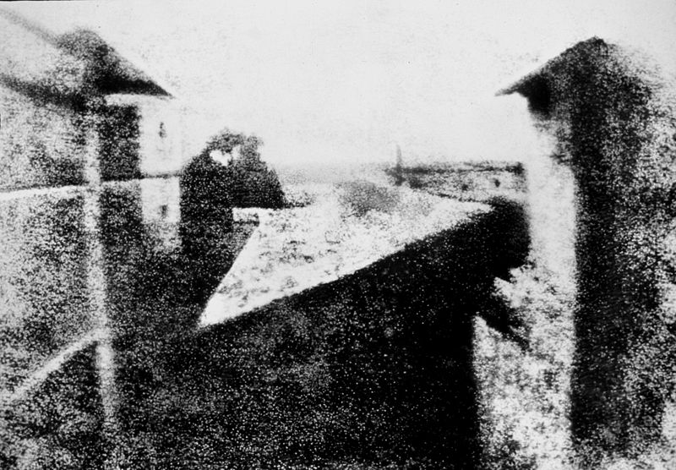
Nicéphore Niépce's earliest surviving photograph of a scene, circa 1826,
"View from the Window at Le Gras," Saint-Loup-de-Varennes (France).

Slide 3
The first permanent photograph was an image produced in 1825 by the French inventor Nicéphore Niépce on a polished pewter plate covered with a petroleum derivative called bitumen of Judea.
Produced with a camera, the image required an eight-hour exposure in bright sunshine.
Bitumen hardens with exposure to light. The unhardened material may then be washed away and the metal plate polished, rendering a negative image which then may be coated with ink and impressed upon paper, producing a print.

Slide 4
In partnership, Niépce and Louis Daguerre refined the existing silver process.
In 1833 Niépce died of a stroke, leaving his notes to Daguerre.
While he had no scientific background, Daguerre made two pivotal contributions to the process.
• He discovered that exposing the silver first to iodine vapour before exposure to light, and then to mercury fumes after the photograph was taken, could form a latent image.
• Bathing the plate in a salt bath then fixes the image.
On January 7, 1839 Daguerre announced that he had invented a process using silver on a copper plate called the daguerreotype.
A similar process is still used today for Polaroid photos.
The French government bought the patent and immediately made it public domain.

Slide 5
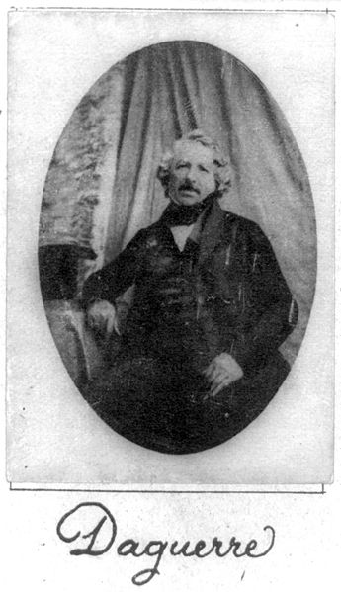
In 1827, Joseph Nicéphore Niépce produced the world's first permanent photograph (known as a Heliograph).
Daguerre partnered with Niépce two years later, beginning a four-year cooperation. Niépce died suddenly in 1833. The main reason for the "partnership", as far as Daguerre was concerned, was connected to his already famous dioramas.

Slide 6
Daguerre first exposed silver-coated copper plates to iodine, obtaining silver iodide. Then he exposed them to light for several minutes. Then he coated the plate with mercury vapor heated to 75° Celsius, to amalgamate the mercury with the silver, finally fixing the image in salt water. These ideas led to the famous Daguerreotype.
The resultant plate produced a mirror-like exact reproduction of the scene. The image was a mirror of the original scene. The image could only be viewed at an angle and needed protection from the air and fingerprints so was encased in a glass-fronted box.

Slide 7
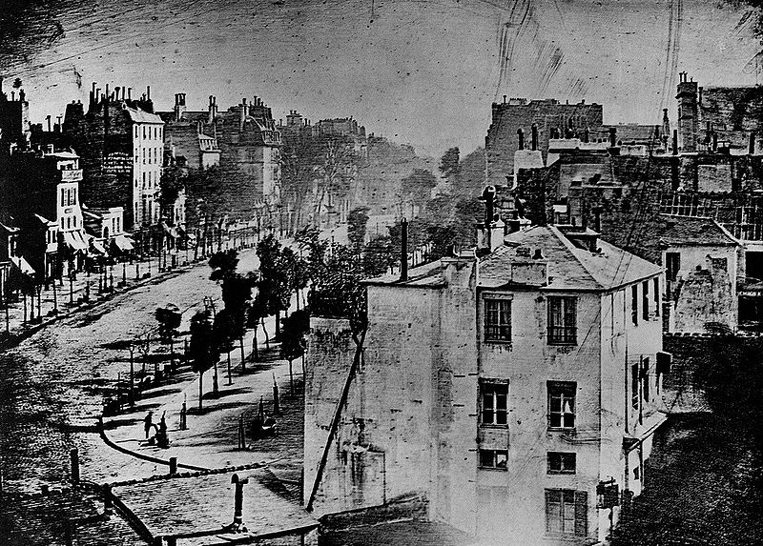
"Boulevard du Temple", taken by Louis Daguerre in late 1838 or early 1839, was the first-ever photograph of a person. It is an image of a busy street, but because exposure time was over ten minutes, the city traffic was moving too much to appear. The exception is a man in the bottom left corner, who stood still getting his boots polished long enough to show up in the picture.

Slide 8
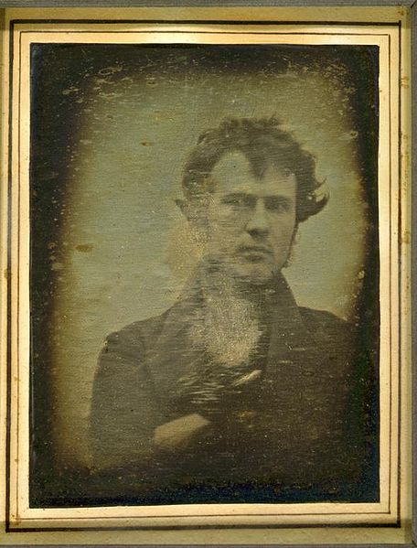
Robert Cornelius, self-portrait,
Oct. or Nov. 1839, approximate quarter plate daguerreotype.
The back reads, "The first light picture ever taken."
This self-portrait is the first portrait image of a human ever produced.

Slide 9
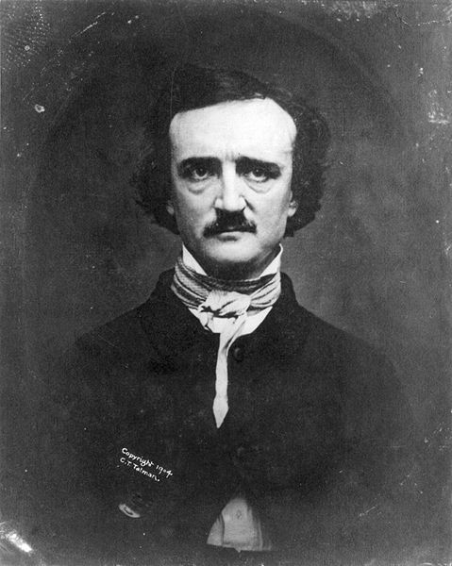
The best-known image of Edgar Allan Poe was a daguerreotype taken in 1848 by W.S. Hartshorn, shortly before Poe's death.

Slide 10
Sir John Herschel made numerous important contributions to photography. He made improvements in photographic processes, particularly in inventing the cyanotype process and variations
(such as the chrysotype), the precursors of the modern blueprint process.
He experimented with color reproduction, noting that rays of different parts of the spectrum tended to impart their own color to a photographic paper. Herschel originally discovered the platinum process on the basis of the light sensitivity of platinum salts.
He discovered sodium thiosulfate to be a solvent of silver halides in 1819, and informed Talbot and Daguerre of his discovery that this "hyposulphite of soda" ("hypo") could be used as a photographic fixer, to "fix" pictures and make them permanent, after experimentally applying it thus in 1839.

Slide 11
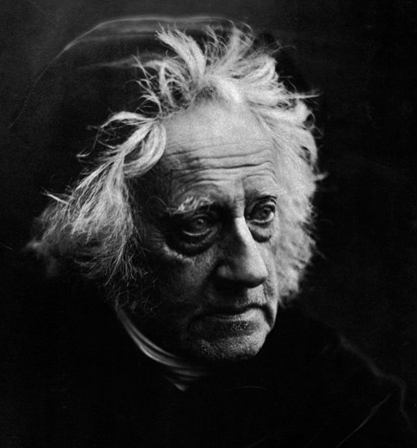
Herschel coined the term photography and applied the terms negative and positive to photography.
John Herschel
1867 photograph by
Julia Margaret Cameron

Slide 12
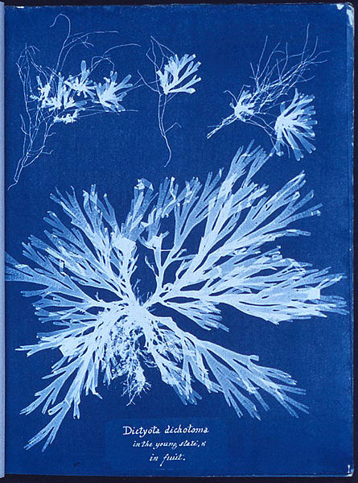
cyanotype
is a photographic printing process that gives a cyan-blue print.
The English scientist and astronomer Sir John Herschel discovered this procedure in 1842. Even though John Herschel is perhaps the inventor of the cyanotype process, Anna Atkins actually brought this to photography. She created a limited series of cyanotype books that documented ferns and other plant life. By using this process, Anna Atkins is regarded as the first female photographer.
Anna Atkins algae

Slide 13
By 1840, William Henry Fox Talbot had invented the calotype process.
He coated paper sheets with silver chloride to create an intermediate negative image.
Unlike a daguerreotype, a calotype negative could be used to reproduce positive prints, like most chemical films do today.
Talbot patented this process, which greatly limited its adoption.
He spent the rest of his life in lawsuits defending the patent until he gave up on photography.

Slide 14
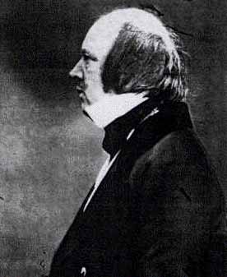
William Henry Fox Talbot was the inventor of the negative / positive photographic process, the precursor to most photographic processes of the 19th and 20th centuries.
He was also a noted photographer who made major contributions to the development of photography as an artistic medium.
His work in the 1850s on photo-mechanical reproduction led to the creation of the photoglyphic engraving process, the precursor to photogravure.
Talbot is also remembered as the holder of a patent which, some say, affected the early development of commercial photography in Britain.

Slide 15
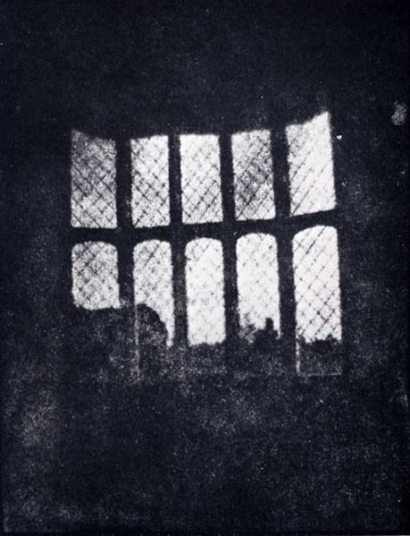
An image of a latticed window in Lacock Abbey in 1835 by Talbot is a print from the oldest photographic negative in existence.

Slide 16
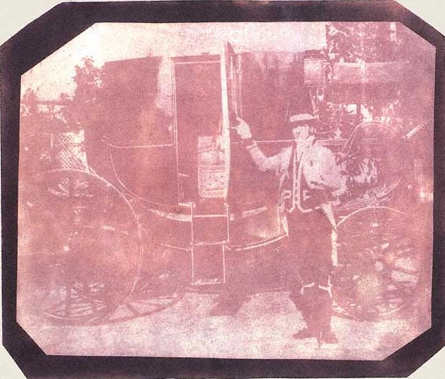
William Henry Fox Talbot, "The Footman", taken in 1840

Slide 17
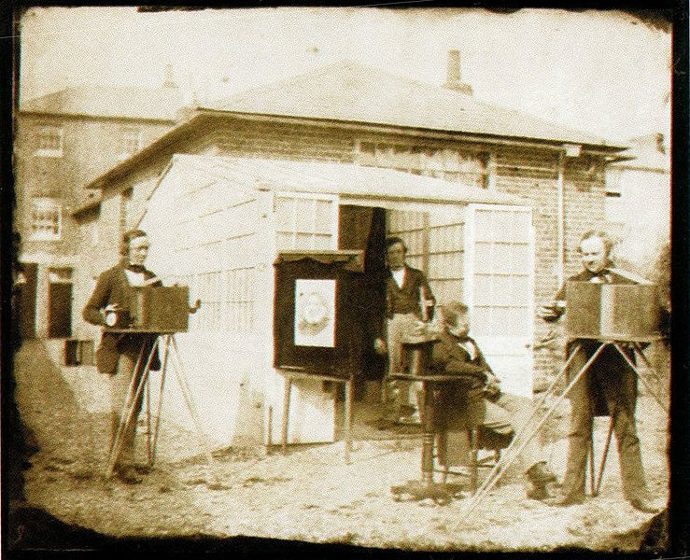
A picture by Talbot made in 1853.

Slide 18
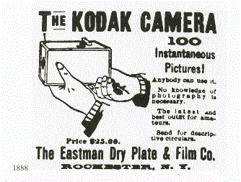

Slide 19
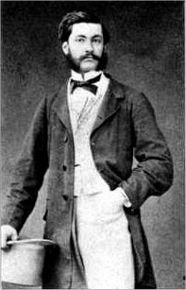
George Eastman founded the Eastman Kodak Company and invented roll film, helping to bring photography to the mainstream.
Roll film was also the basis for the invention of the motion picture film in 1888 by world's first filmmaker, Louis Le Prince, and a decade later by his followers Léon Bouly, Thomas Edison, the Lumière Brothers and Georges Méliès.
Louis Aimé Augustin Le Prince
born 28 August 1842, vanished 16 September 1890) was an inventor who is considered by many film historians as the true father of motion pictures who shot first moving pictures on paper film using a single lens camera.

Slide 20
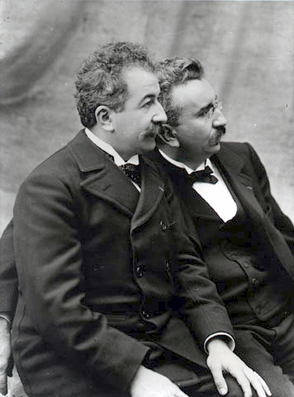
The Lumière brothers,
Auguste and Louis,
were among the earliest filmmakers.
(Appropriately, "lumière" translates as "light" in English.)
Their moving images had an immediate and significant influence on popular culture with L'Arrivée d'un Train en Gare de la Ciotat (literally, "the arrival of a train at La Ciotat Station", but more commonly known as Arrival of a Train at a Station). Their actuality films, or actualités, are often cited as the first, primitive documentaries. They also made the first steps towards comedy film with the slapstick of L'Arroseur Arrosé.

Slide 21
The Autochrome Lumière is an early color photography process. Patented in 1903 by the Lumière brothers in France and first marketed in 1907, it remained the principal color photography process available until it was superseded by the advent of color film during the mid 1930s.

Slide 22
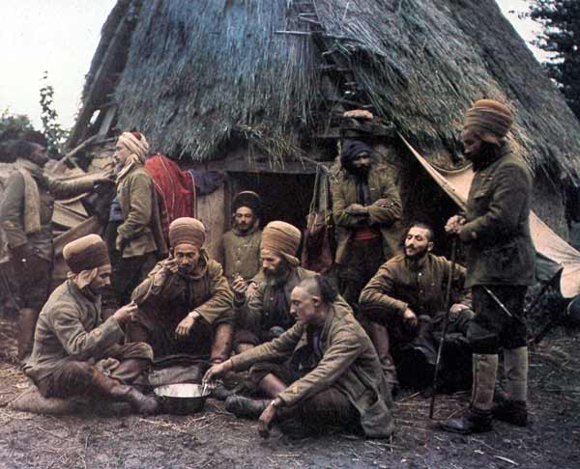
Autochrome color picture by Jean-Baptiste Tournassoud of North-African soldiers, Oise, France, 1917

Slide 23
Chronophotography is a Victorian application of science (the study of movement), and art (photography). It is the technique precursor to cinematography.
The word is from the Greek chronos and photography, "pictures of time."
Chronophotography is divided into two separate processes:
Motography (continuous exposure of the subject) and
Strobophotography (intermittent exposure of the subject).

Slide 24
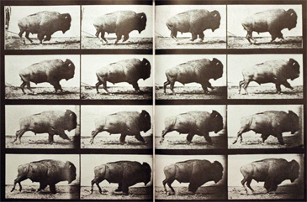
Eadweard J. Muybridge (1830 –1904) was an English photographer, known primarily for his early use of multiple cameras to capture motion, and his zoopraxiscope, a device for projecting motion pictures that pre-dated the celluloid film strip that is still used today.

Slide 25
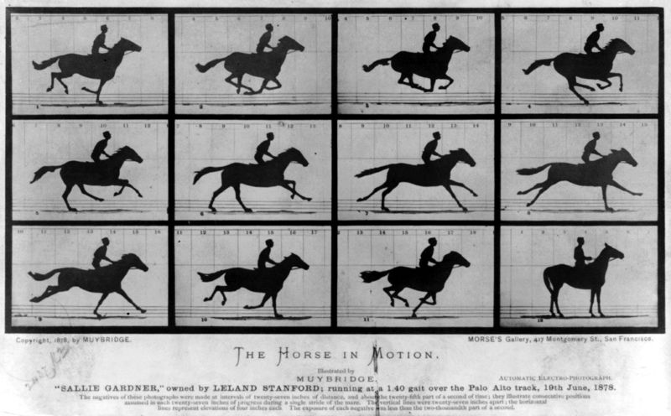

Slide 26
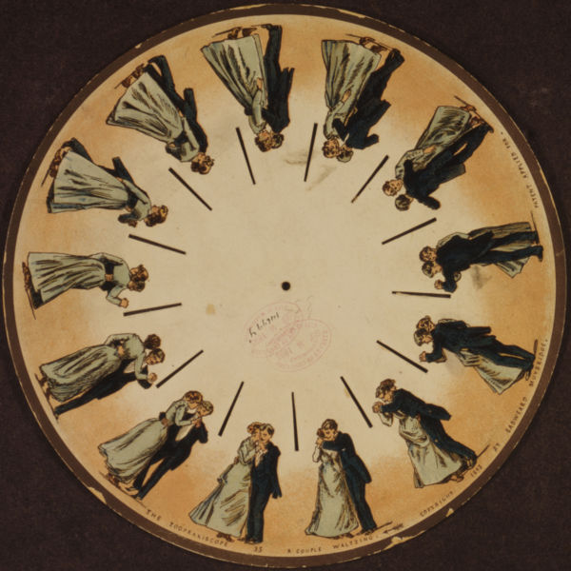
The phenakistoscope (also spelled phenakistiscope) was an early animation device, the predecessor of the zoetrope.
A phenakistoscope disc by Muybridge (1893).

Slide 27
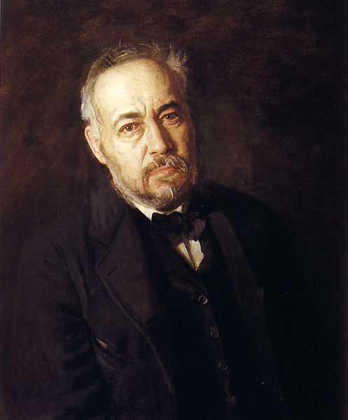
Thomas Eakins (1844 –1916) was a realist painter, photographer, sculptor, and fine arts educator.
He is widely acknowledged to be one of the most important artists in American art history.

Slide 28
Thomas Eakins has been credited with having "introduced the camera to the American art studio”.
During his study abroad, he was exposed to the use of photography by the French realists, though the use of photography was still frowned upon as a shortcut by traditionalists.
In the late 1870s he was introduced to the photographic motion studies of Eadweard Muybridge, particularly the equine studies, and became interested in using the camera to study sequential movement.

Slide 29
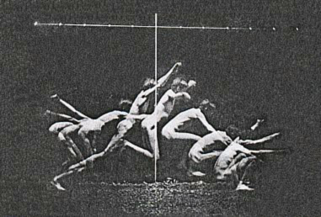
Study in Human Motion. Photograph, Thomas Eakins.

Slide 30
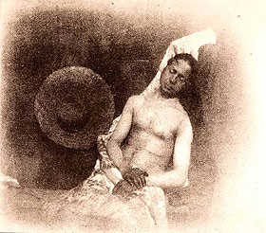
Hippolyte Bayard (1801 - 1887) was one of the earliest photographers in the history of photography, inventing his own photography process known as direct positive printing and presenting the world's first public exhibition of photographs on June 24, 1839.
Bayard's Self Portrait as a Drowned Man

Slide 31
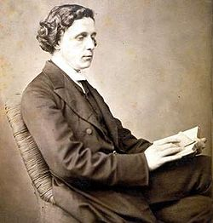
In 1851 Frederick Scott Archer invented the collodion process.
Photographer and children's author Lewis Carroll used this process

Slide 32
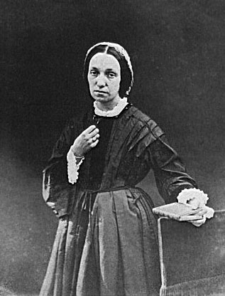
Julia Margaret Cameron (1815 –1879) was a British photographer. She became known for her portraits of celebrities of the time, and for Arthurian and similar legendary themed pictures.
The bulk of Cameron's photographs fit into two categories – closely framed portraits and illustrative allegories based on religious and literary works. In the allegorical works in particular, her artistic influence was clearly Pre-Raphaelite, with far-away looks and limp poses and soft lighting.

Slide 33
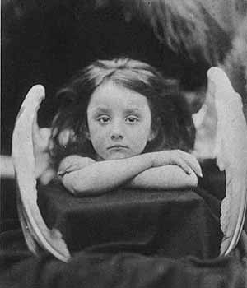
Julia Margaret Cameron, I Wait

Slide 34
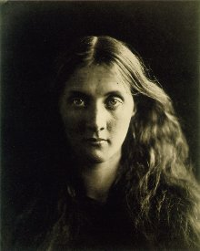
Cameron portrait of Julia Jackson, Cameron's niece, favourite subject, and mother of the author Virginia Woolf.

Slide 35
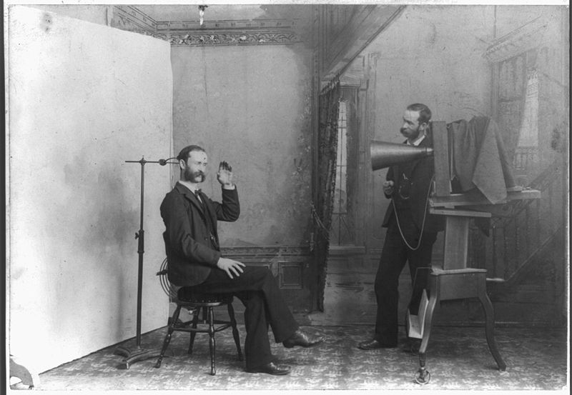
A photographer appears to be photographing himself in a 19th-century photographic studio. (c. 1893)

Slide 36
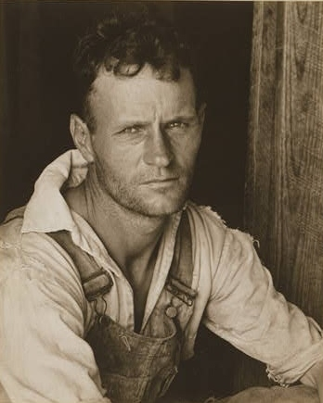
Born in St. Louis, Missouri,
Walker Evans was part of a well-to-do family.
He was an American photographer best known for his work for the Farm Security Administration documenting the effects of the Great Depression.
Much of Evans' work from the FSA period uses the large-format, 8x10-inch camera. He said that his goal as a photographer was to make pictures that are "literate, authoritative, transcendent"
Photo of a sharecropper by Walker Evans for the U.S. Resettlement Administration

Slide 37
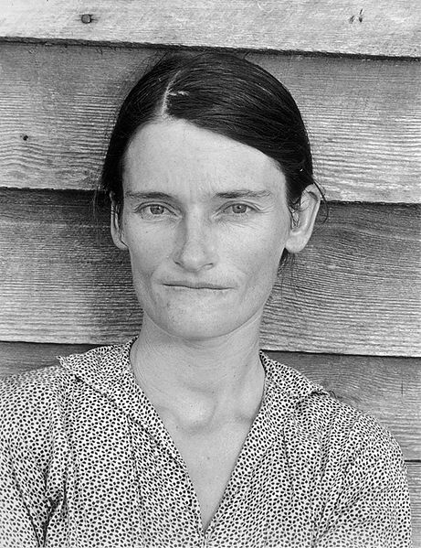
Allie Mae Burroughs, a symbol of the great depression.

Slide 38
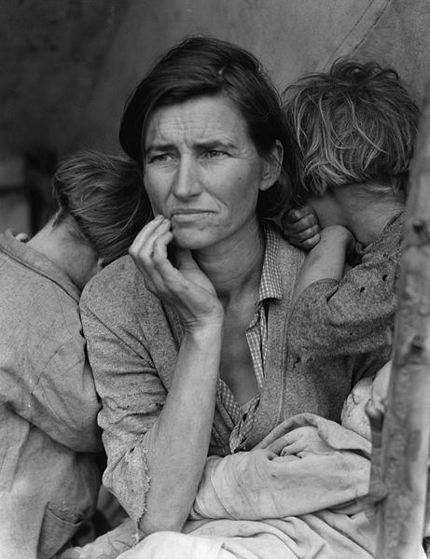
Dorthea Lange was educated in photography in New York City, in a class taught by Clarence H. White.
She was informally apprenticed to several New York photography studios, including that of the famed Arnold Genthe. In 1918, she moved to San Francisco, and by the following year she had opened a successful portrait studio
Lange's Migrant Mother, Florence Owens Thompson

Slide 39
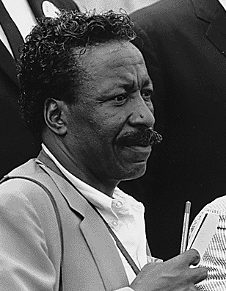
Gordon Parks (1912 –2006) was a groundbreaking American photographer, musician, poet, novelist, journalist, activist and film director.
He is best remembered for his photo essays for Life magazine and as the director of the 1971 film Shaft.

Slide 40
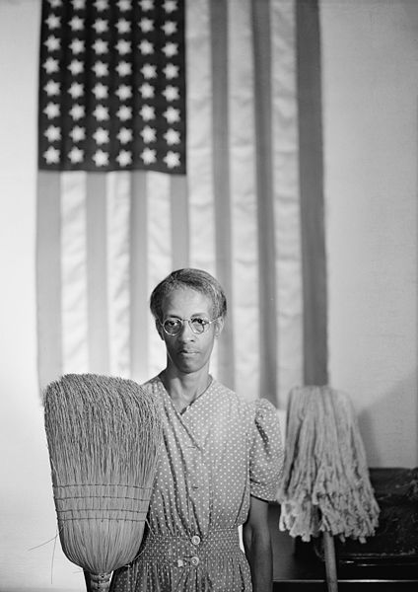
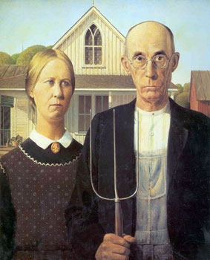
American Gothic (Ella Watson) is a parody of the Grant Wood painting of the same name.

Slide 41
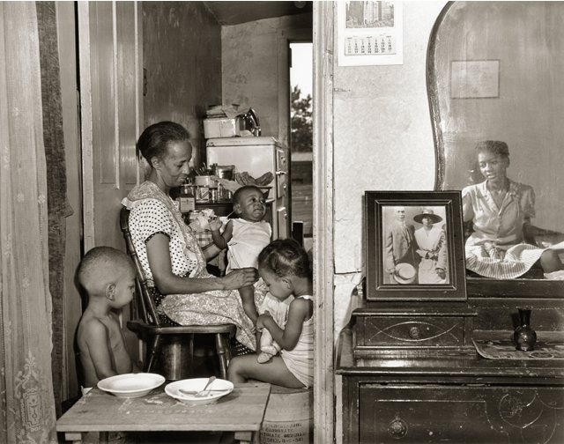
One of Parks' later FSA photos of Ella Watson and her family

Slide 42
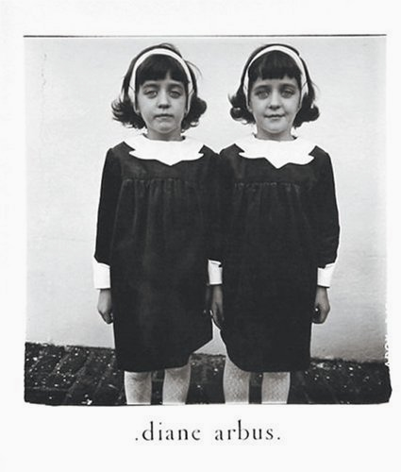
Diane Arbus (March 14, 1923 – July 26, 1971) was an American photographer, noted for her portraits of people on the fringes of society, such as transvestites, dwarfs, giants, prostitutes and ordinary working class citizens, in unconventional poses and settings.
Identical Twins, Roselle, New Jersey, 1967, on the cover of Diane Arbus: An Aperture Monograph.

Slide 43
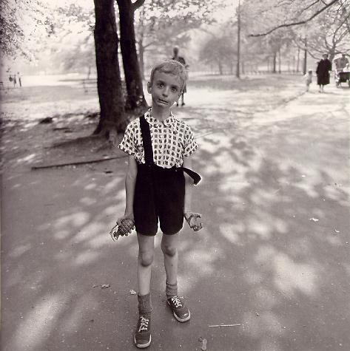
Arbus' Child with Toy Hand Grenade in Central Park, New York City (1962)

